Slide 1
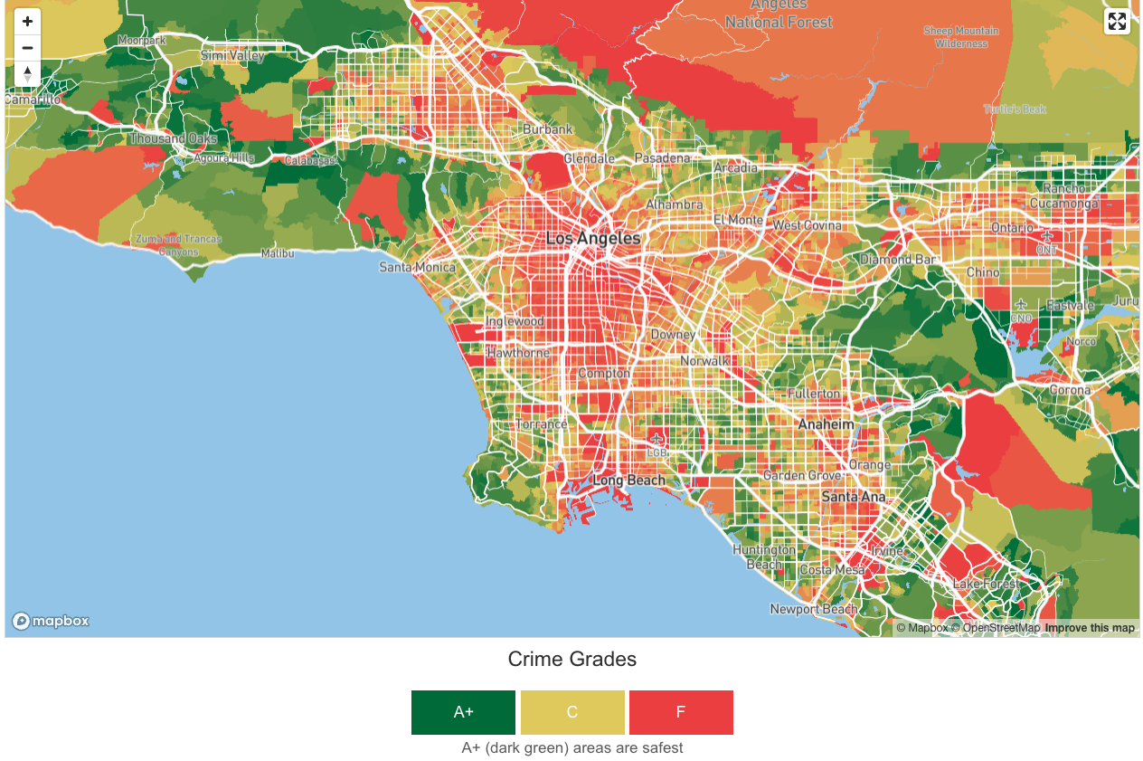


Leveraging Machine Learning for Advanced Crime Prediction in Los Angeles
Chapters 4 & 5
National University: ANA699C MS Data Science Capstone
Program Director: Dr. Jodi Reeves
Instructor: Dr. Mario Missakian
Project Advisor: Dr. Jawad Shatha
Project Sponsor: Dr. Faye Anderson
Crimegrade.org (2024)
Team Name: TriForce Analytica:
Elijah C Walker, Hengly Aun, Magnus Aghe
Date: March 17 2024
Notes:
===== Script:
Welcome everyone!
We are Team “TriForce Analytica”. We are Elijah, Hengly, and Magnus, students in the Master's Degree in Data Science program.
Our logo is on the edge left corner.
Our project title is: Leveraging Machine Learning for Advanced Crime Prediction in Los Angeles.
Today, we are presenting Chapter 4 the Results with tuning, and Chapter 5 conclusion and future work.​
=====
Link to image: https://crimegrade.org/safest-places-in-los-angeles-county-ca/

Slide 2
We tune our crime prediction models for enhanced results and conclusion.
1
Introduction
2
Literature Reviews
3
Methodology
4
Results
5
Conclusion and
Future works
Applied tuning
Conclusion
Future pathway
Prediction Analyst
Crime Classification
Evaluation metrics
Time Series: 44 models
ML: 24 -> 16 models
Crime Occurrences
Hypothesis & Action
3 Hypothesis
Time Series: ARIMA, LSTMs
ML: 6 algorithms
Tuning Results
60 models
Notes:
This week for the project update, we're sharing what we found after making adjustments to our models to get better predictions, along with our final thoughts.
We'll revisit our three main questions and explain how we adjust our models.
We'll show you how our models did after tuning by looking at some key performance numbers and comparing them to how they did before.
Our team will explain how these tuned models help answer our three big questions.
A key part of our results is showing you how these adjustments improved our predictions.
To wrap up, we'll talk about our conclusions and what we think the future holds for projects like this in predicting crimes.
============
Our 3 hypothesis question with response and to get answer around those questions.
And what are the algorithms we use to get our answers.
The evaluation metrics that we use to evaluate the models that builds
The detail of our prediction analysis for:
crime classification and
crime occurrences hotspot
Last but not lease, is the our preliminary results of what found in 34 models that we built.
-------
- What role do victim demographics play in crime prediction?
We intend to explore the relationships between demographic variables and crime types to identify potential patterns or trends before they occur.
=> Crime type
- What are the hotspots of crime occurrences in LA, and how can we predict the types of crime?
Can we predict future hotspot in LA: # of crime in AREA We propose to investigate factors such as time of day, day of the week, geographical locations, and types of crime in LA.
=> ARIMA: Time series
-Do specific weather conditions in LA influence crime patterns and frequencies?
We propose to construct a model to explore the correlation between weather and crime, aiming to guide law enforcement in resource planning based on weather-related crime trends.
=> Time serial: Weather & Date
-----

Slide 3
We extended the Time Series from 10 to 44 models, and reduced crime type from 24 to 16 models, all metrics evaluation stayed the same.
AREA | ARIMAM | LSTMs
77th Street | 44 models' evaluation metrics: Root Mean Squared Error (RMSE)
Southwest
Central
Pacific
N Hollywood
Southeast
Hollywood
Northeast
Van Nuys
Newton
Mission
Rampart
Wilshire
West LA
West Valley
Olympic
Topanga
Devonshire
Harbor
Hollenbeck
Foothill
The whole LA
Hypothesis 1
DATE_OCC
AREA | ARIMAM | LSTMs
South Bureaus | 10 models evaluation metrics: Root Mean Squared Error (RMSE)
West Bureaus
Central Bureaus
Valley Bureaus
The whole LA
Hypothesis 2 & 3
Crime_Category
Models | LR | RF | DT | XGBOOST
All relevant predictors | 16 models, evaluation metrics: Accuracy Precision Recall F1 Score Mathews Correction Coefficient Cohen’s Kappa Log Loss
All relevant predictors without weather
All relevant predictors without victim demographics
All relevant predictors without weather and victim demographics
Notes:
Start with our main questions and how we approached them with our models.
for our Hypothesis 1, we looked at crime hotspots and when they happen. We're predicting the number of crimes on any given day, using two TIME Series algorithms called ARIMA and LSTMs.
We've expanded our work from 10 to 44 different models, focusing on each erea, and the whole LA as another area.
Then for hypothesis 2 and 3, we explored if weather plays a role in the kind of crimes that occur, and how much who the victims are can tell us about crime patterns.
For these, we're looking at types of crimes and predicting which ones are likely.
Initially, we used 6 different techniques but narrowed it down to 4 by leaving out KNN and Linear SVM.
We're still using the same ways to measure how well our models are doing, such as accuracy, precise and F1-score, Log Loss etc.
======
From the left is our hypothesises, and the models and algorithms we apply.
=> hypothesis 1, the spatial-temporal crime hotspots within the district.
The target variable hypothesis 1 is DATE Occurrence, we are predicting how many crime occurrences on the date.
We are using 2 algorithms of Time Series, the ARIMA and LSTMs. Initially 10 model but now is 44 models of Time Series analysis we are gong to share.
Because before we group areas by Bureaus, now predicting by it's own areas and one whole LA area.
=>For Hypothesis 2: regarding with weather condition correlation with crime incidence and typology.
And Hypothesis 3: the significance of victim demographic in patterning crime
The Target variable for Hypothesises 2 and 3 is Crime categories, we are predicting the accuracy of type of crime will be happen.
We built 4 models, the algorithms initially 6 but now is 4. We dropped KNN, and Linear SVM.
The evaluation metrics still the same such as accuracy, precision, and Recall, F1 score.
=====
For these 2 hypothesis we are using the crime type as the category classification with 6 algorithms, multiply by 4 models.
All relevant predictors
All relevant predictors without weather
All relevant predictors without victim demographics
All relevant predictors without weather and victim demographics
In total we are going to share 24 model's results.
- What role do victim demographics play in crime prediction?
We intend to explore the relationships between demographic variables and crime types to identify potential patterns or trends before they occur.
=> Crime type
- What are the hotspots of crime occurrences in LA, and how can we predict the types of crime?
Can we predict future hotspot in LA: # of crime in AREA We propose to investigate factors such as time of day, day of the week, geographical locations, and types of crime in LA.
=> ARIMA: Time series
-Do specific weather conditions in LA influence crime patterns and frequencies?
We propose to construct a model to explore the correlation between weather and crime, aiming to guide law enforcement in resource planning based on weather-related crime trends.
=> Time serial: Weather & Date
-----
Following from the previous slide we are using the Time Series to predict the hotspot of crime.
By using the ARIMA and LSTMs. The 5 bureaus were originated separated by LADP itself.
South Bureaus
West Bureaus
Central Bureaus
Valley Bureaus
The whole LA
The models will be evaluated by using Root Mean Squared Error.
For the crime classification categorical, there are 4 based models, and by applying 6 algorithms, therefore we got 24 models.
Each model will evaluated by:
Accuracy
Precision
Recall
F1 Score
Mathews Correction Coefficient
Cohen’s Kappa
Log Loss
Next, I will pass to Magnus to continue for more detail.

Slide 4
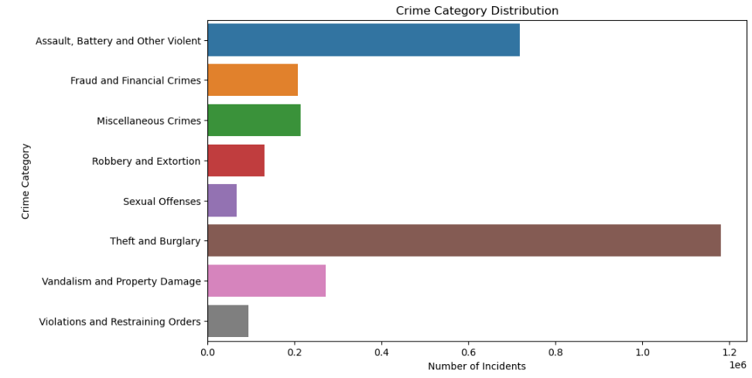
The crime categories across the 16 models with 8 types of crime increased accuracy from 79 to 81% under the Random Forest (RF) algorithm after tuning.
Tuning all models with:
Hyperparameters
Add feature
Parameter higher
Parameter lower
Accuracy
81%
Model 1
Model 2
Add TIME_OCC to predictor feature
Model 1 - All relevant predictors
Model 2 - Without weather features
Model 3 - Without victim demographics
Model 4 – Without weather and victim demographics
Notes:
=====Script:
The crime category variable is our target variable, which was reduced from 144 to 8, hence we have 8 main crime types.
Model 1, includes all relevant predictors,
model 2 excludes only weather features;
model 3 excludes only victim demographics,
whilst model 4 excludes both weather and victim demographic features.
With the 16 models that we built, we tuned with hyperparameters and increased and decreased parameters, all the results we got were lower than our 79% accuracy.
But by adding TIME occurrences to be part of the predictor feature we got better 81% which is better.
We also check any multicollinearity as well.
==== Now, over to Magnus to talk about Time Series algorithm.

Slide 5
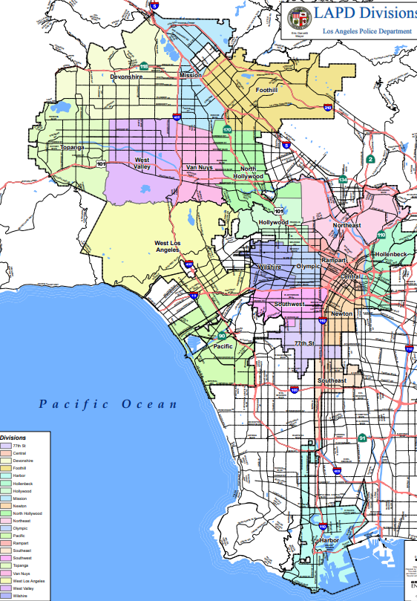
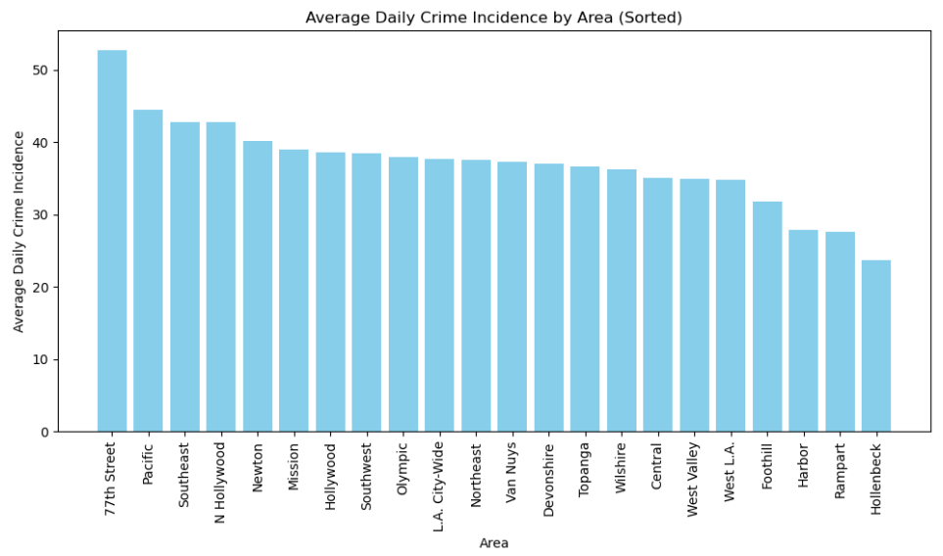

Predicting crime hotspots according to the 21 areas in L.A. provides a more granular insight into crime occurrences in the city.
(Navigate LA, 2024)
Notes:
=====Script:
Hello everyone and thank you Hengly.
To provide a more granular prediction of crime hotspots in Los Angeles, we look at the 21 areas individually, and the whole city of L.A. as one area; making it a total of 22 areas.
Whilst the average daily crime incidence in Los Angeles is 37.61, there are an average of 53 crimes per day in 77th Street area, making it the area with the highest crime hotspot. With 44 crimes, Pacific area ranks 2nd in average daily crime incidence rates, but 4th in total number of crimes. Hollenbeck area has the least average crime incidence rate of about 24 crimes per day. It however did not produce the least total number of crimes
====

Slide 6
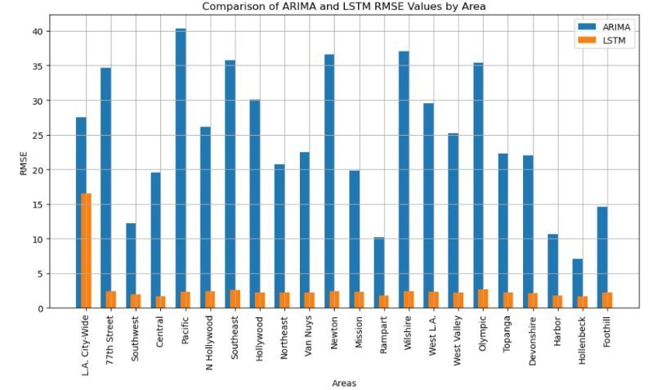
LSTM outperforms ARIMA across every geographical area by RMSE.
AREA NAME | # of Areas | ARIMA (RMSE) | LSTM (RMSE)
The whole LA | 21 | 27.57 | 16.55
77th Street | 1 | 34.64 | 2.46
Southwest | 1 | 12.20 | 1.92
Central | 1 | 19.53 | 1.72
Pacific | 1 | 40.33 | 2.36
N Hollywood | 1 | 26.15 | 2.40
Southeast | 1 | 35.79 | 2.63
Hollywood | 1 | 30.08 | 2.24
Northeast | 1 | 20.78 | 2.22
Van Nuys | 1 | 22.45 | 2.23
Newton | 1 | 36.63 | 2.43
Mission | 1 | 19.86 | 2.35
Rampart | 1 | 10.17 | 1.73
Wilshire | 1 | 37.02 | 2.45
West LA | 1 | 29.57 | 2.32
West Valley | 1 | 25.22 | 2.19
Olympic | 1 | 35.40 | 2.65
Topanga | 1 | 22.32 | 2.21
Devonshire | 1 | 21.99 | 2.18
Harbor | 1 | 10.71 | 1.74
Hollenbeck | 1 | 7.05 | 1.69
Foothill | 1 | 14.60 | 2.23
Avg. RMSE |  | 24.4 | 2.21
Notes:
=====Script:
We ran 44 models, 22 for ARIMA and 22 for LSTM, and came up with the results shown on the screen.
The citywide L.A. area had ARIMA RMSE of 27.57 compared to LSTM’s 16.55. For the individual areas, ARIMA averaged RMSE values of 24.4, with a low of 7.05 for Hollenbeck and a high of 40.33 for Pacific area.
LSTM on the other hand, averaged RMSE values of 2.21, with a low of 1.69 also for Hollenbeck and a high of 2.65 for Pacific area.
The lower the root mean squared error, the better the model performance of predicting crime occurrences. LSTM outperforms ARIMA across all the 22 geographical areas.
The table on the left shows the RMSE values of the four bureaus. Both ARIMA and LSTM for the 22 areas had lower RMSE values than for the 5 bureaus (LA city inclusive).
====

Slide 7
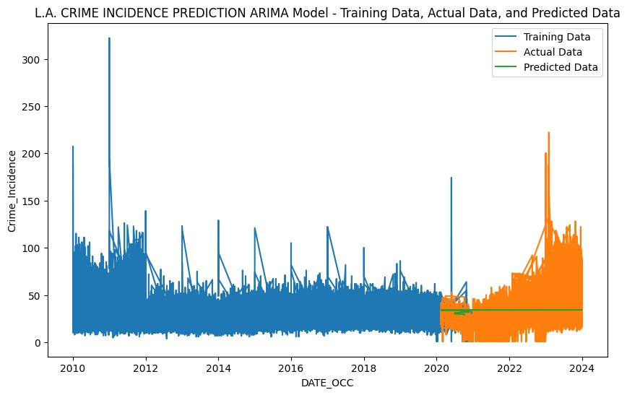
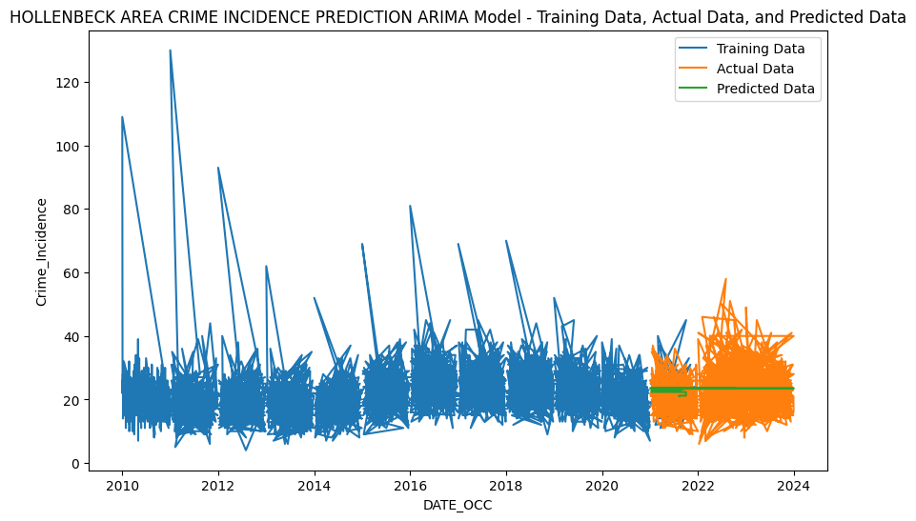
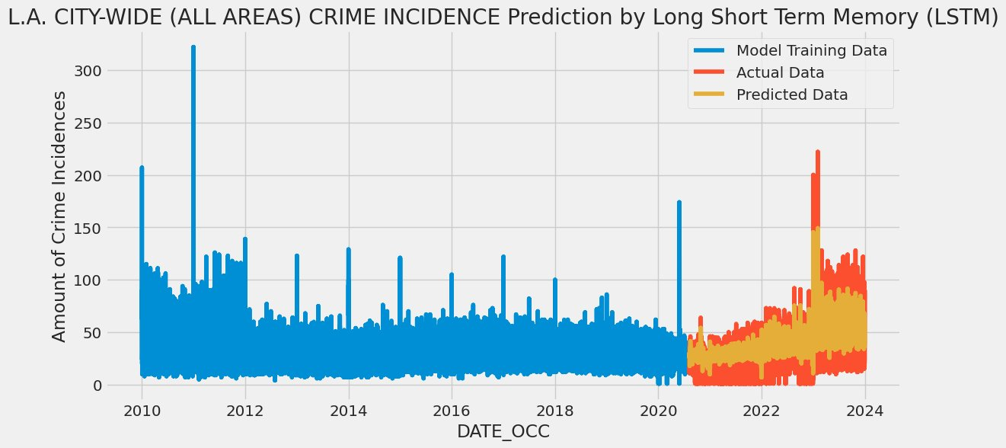
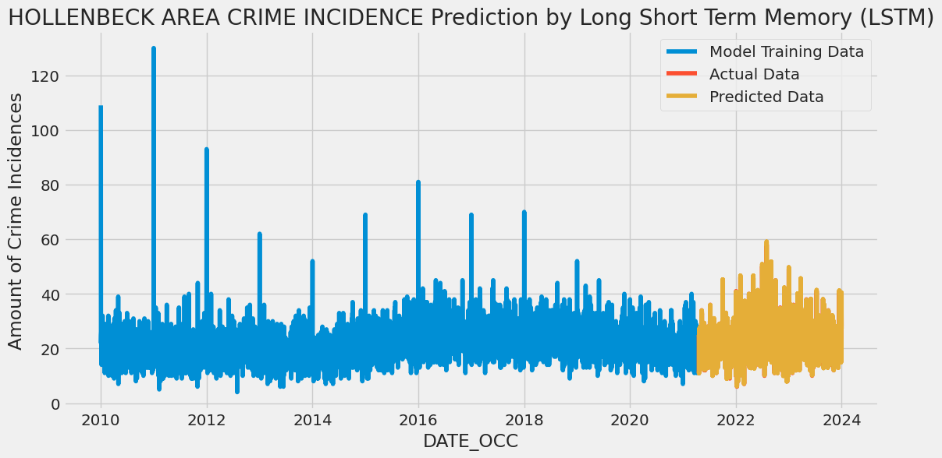
LSTM model prediction charts outline their superiority in capturing complex temporal dependencies over ARIMA.
Notes:
=====Script:
LSTM prediction charts are bottom in the slides. On the left, is the crime incidence prediction of the entire Los Angeles city-wide. On the right is Hollenbeck area, which has the lowest RMSE value of all the areas.
Both ARIMA and LSTM models are compared side by side. For LSTM (on the right), the predicted data (yellow legend) almost perfectly matches the actual data (orange legend), showing remarkably high accuracy and unnoticeable marginal errors, compared to ARIMA model’s predicted data (green legend on the left).
Now, over to Elijah for results on the crime categorization classification.
====

Slide 8
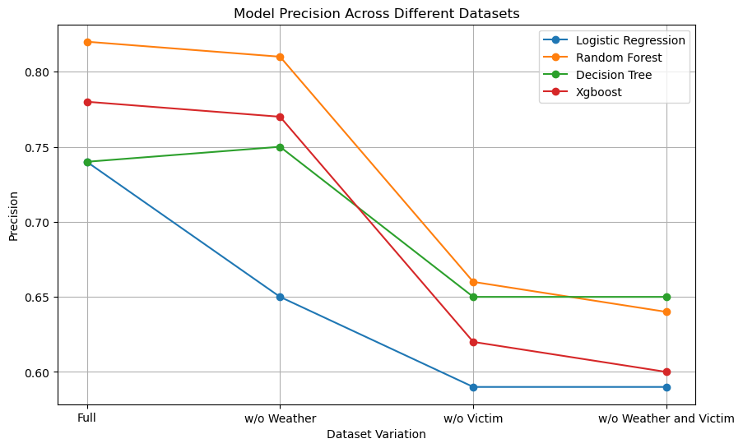
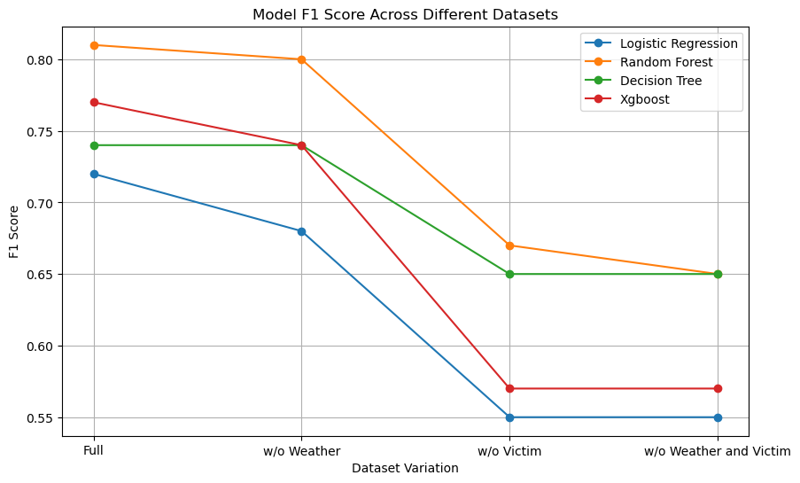
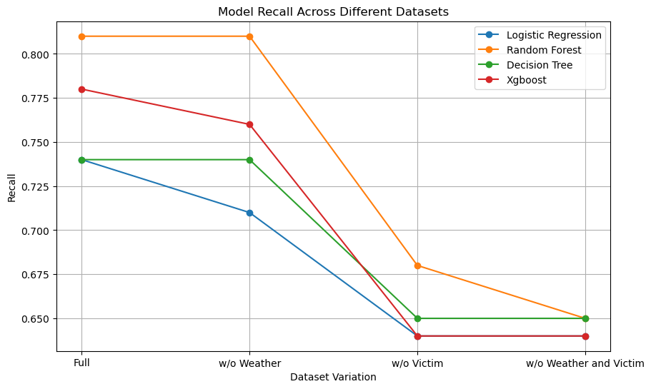
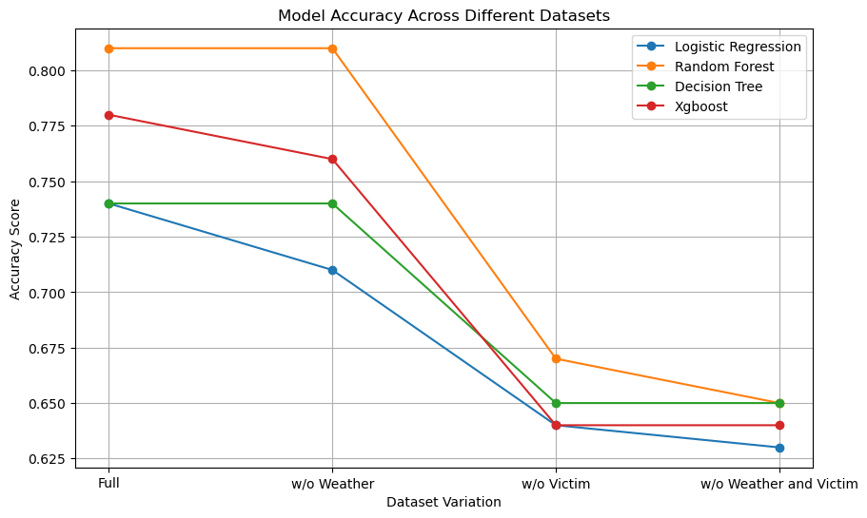
All classification models showed similar performance levels when trained on each of the four dataset variations
8
Notes:
Good evening everyone. To continue on from last week, we were advised to remove certain models that were taking too long to train, or performing poorly such as K Nearest Neighbors and support vector classifiers. Our four final algorithms were Logistic Regression, Random Forests, Decision Trees, and XGBoost. We can see a clear pattern in the 4 charts above for each models accuracy, precision, recall and f1 score. The four different datasets allowed a total of 16 models to be trained to see how each performed in the presence of all data, no weather data, no victim demographics data, or missing both victim and demographics data. When weather data is removed, some models show a very slight decline in performance and some do not change at all. However, all performance metrics worsen visibly when victim demographic information is removed.

Slide 9
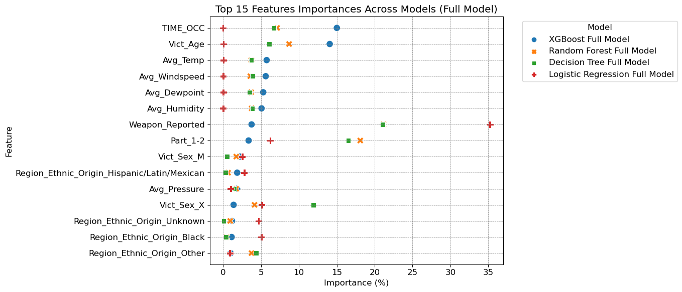
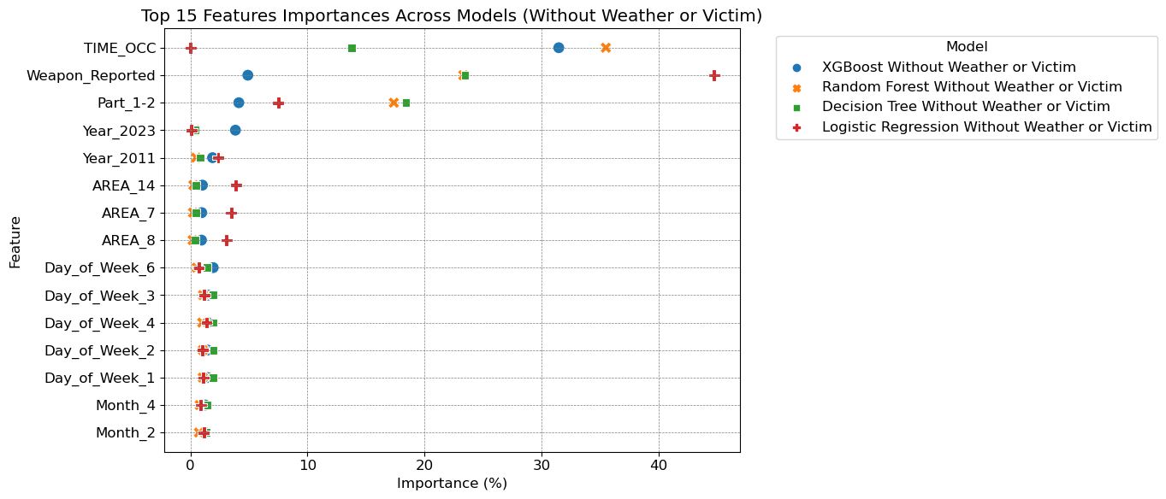
Time of Occurrence, Weapon Reported, and Part 1-2 are among the top features for all models and datasets, while hypothesis variables vary in terms of feature importance.
9
Notes:
We did a thorough assessment of all feature importances, scaled to percentages, to see how hypothesis variables were influencing model outcomes. In all cases, weapon reported, part 1-2, and time of occurrence were in the top 15 most important features for all models. When weather information is removed, performance parameters change minimally and other features become more important.

Slide 10
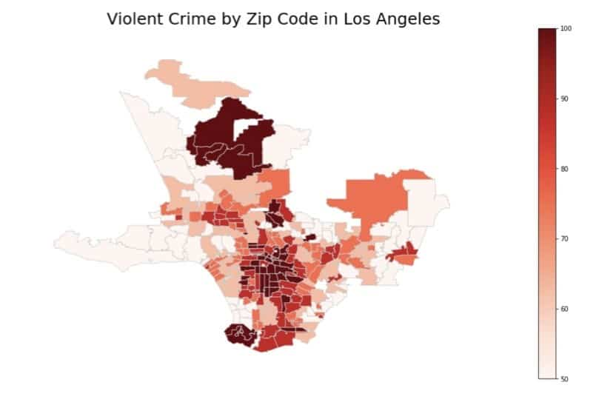

Future research can include implementing these algorithms and methods on other areas, integrating real-time data feeds, hybrid models, and more inclusive datasets.
10
Google (n.d)
Notes:
Before we present our final results, we also created and merged our chapter 5. Some suggestions we made for future works are implementing these methods in other areas or regions, hybrid model building, an datasets that are more feature inclusive. Due to sparseness of some location data with our dataset, our hotspot analysis was limited to areas, but with more resolute location data, a more refined predictive model could be considered in the future. AI is making it way into crime prediction in ways like sound detections for things like gunshots, and even AI controlled body cams which are even used in Los Angeles now as shown on the image in the right.

Slide 11
Conclusion: Victim demographic information is important when predicting crime category, and crime hotspots can be predicted with good accuracy.
Hypothesis 1:
Future crime hotspots and amounts can be predicted in Los Angeles
Achieved high time series predictive accuracy/low error for the 21 areas of LA using LSTM, showing future crime amounts can be predicted accurately.
All machine learning models showed little to no change in performance when weather data is present or removed, indicating it does not play a significant role in crime category prediction.
Hypothesis 2:
Weather information has an impact on predicting crime categories in Los Angeles
Hypothesis 3:
Victim Demographic Information has an impact on predicting crime categories in Los Angeles
All machine learning models showed a large decline in performance when removing victim demographics features, confirming importance in predictive crime modeling.
Notes:
So to conclude this lengthy capstone research project, we were able to prove two hypothesis to likely be true, while one ended up being false. Unfortunately, weather information did not appear to add good predictive value to crime categories. On a better note, there are clear trends in the impacts of victim demographics on crime types. Also, when training neural networks to perform time series analysis for crime amounts, a very low Root Mean Squared Error was achieved for several of the 21 areas using LSTM, showing the future crime amounts can be predicted in the different areas of LA.

Slide 12
References
Ahmed, W., Siddhartha Sankar Biswas, & Tabrez Nafis. (2017). Performance Analysis of Naïve Bayes Algorithm on Crime Data Using Rapid Miner. International Journal of Advanced Research in Computer Science, 8(5), 683–687. https://doi.org/10.26483/ijarcs.v8i5.3393
Alghamdi, D. M. (2017, October 27). A Data Mining Based Approach For Burglary Crime Rate Prediction. Retrieved March 4, 2024, from indigo.uic.edu website: https://hdl.handle.net/10027/21894
Arpa, K. F., Mittra, T., Ferdous, T., Jahan, N., Khan Tayna, R. A., Hasan, M., … Ali, M. S. (2023). A Machine Learning and Deep Learning Integrated Model to Detect Criminal Activities. 2023 4th International Conference on Big Data Analytics and Practices (IBDAP). https://doi.org/10.1109/ibdap58581.2023.10272002
Babakura, A., Sulaiman, N., & Yusuf, M. (2014). Improved Method of Classification Algorithms for Crime Prediction. Retrieved from https://ieeexplore.ieee.org/abstract/document/7013130
Bell, A., Solano-Kamaiko, I., Nov, O., & Stoyanovich, J. (2022). It’s Just Not That Simple: An Empirical Study of the Accuracy-Explainability Trade-off in Machine Learning for Public Policy. 2022 ACM Conference on Fairness, Accountability, and Transparency. https://doi.org/10.1145/3531146.3533090
Bhadri, M. (2023). The Effect of Demographic Imbalance on Crime. Theses. Retrieved from https://repository.rit.edu/theses/11496/
Ensign, D., Friedler, S. A., Neville, S., Scheidegger, C., & Venkatasubramanian, S. (2018, January 21). Runaway Feedback Loops in Predictive Policing. Retrieved from proceedings.mlr.press website: https://proceedings.mlr.press/v81/ensign18a.html
Hardyns, W., & Khalfa, R. (2022). Predicting Crime Across Cities and Regions: A Comparative Analysis of Predictive Modelling in Three Belgian Settings. Applied Spatial Analysis and Policy, 16. https://doi.org/10.1007/s12061-022-09485-9
Hayes, R. (2022, August 4). LAPD shifts about 200 officers to Hollywood as residents report increase in crime. Retrieved March 4, 2024, from ABC7 Los Angeles website: https://abc7.com/hollywood-california-crime-prevention-los-angeles-police-department/12096655/
Hernandez, A. P. (1990). Artificial intelligence and expert systems in law enforcement: Current and potential uses. Computers, Environment and Urban Systems, 14(4), 299–306. https://doi.org/10.1016/0198-9715(90)90004-d
Hosmer, D. W., Jr., Lemeshow, S., & Sturdivant, R. X. (2013). Applied Logistic Regression. In ProQuest Ebook Central. Newark, UNITED STATES: John Wiley & Sons, Incorporated. Retrieved from https://ebookcentral.proquest.com/lib/nu/reader.action?docID=1138225

Slide 13
References
Kabirou, K., & Kishore, K. (2019). Using Machine Learning and Recurrent Neural Networks for Efficient Crime Detection and Prevention. Journal of Emerging Technologies and Innovative Research, 6(6), 395-402.
Karimi-Haghighi, M., & Castillo, C. (2021). Enhancing a recidivism prediction tool with machine learning. Proceedings of the Eighteenth International Conference on Artificial Intelligence and Law. https://doi.org/10.1145/3462757.3466150
Khalaf, E. F., & Taresh, A. H. (2022). Survey: Crime Prediction using Machine Learning Approach. Journal of Al-Qadisiyah for Computer Science and Mathematics, 14(3), 51-57. https://doi.org/10.29304/jqcm.2022.14.3.986
Khan, M., Ali, A., & Alharbi, Y. (2022). Predicting and Preventing Crime: A Crime Prediction Model Using San Francisco Crime Data by Classification Techniques. Complexity, 2022, Article ID 4830411. https://doi.org/10.1155/2022/4830411
Kim, S., Joshi, P., Kalsi, P. S., & Taheri, P. (2024). Crime Analysis Through Machine Learning. Fraser International College, Simon Fraser University.
Kim, S., & Lee, S. (2023). Nonlinear relationships and interaction effects of an urban environment on crime incidence: Application of urban big data and an interpretable machine learning method. Sustainable Cities and Society, 91, 104419.
Letourneau, S., Ell, N., Cheung, P., McCaskill, J., & El-Hajj, M. (2018). The effects of neighbourhood characteristics on crime incidence. In 2018 IEEE 8th Annual Computing and Communication Workshop and Conference (CCWC) (pp. 720-726). Las Vegas, NV, USA: IEEE. https://doi.org/10.1109/CCWC.2018.8301675
Liang, W., Cao, J., Chen, L., Wang, Y., Wu, J., Beheshti, A., & Tang, J. (2023). Crime prediction with missing data via spatiotemporal regularized tensor decomposition. IEEE Transactions on Big Data, 9(5). https://doi.org/10.1109/TBDATA.2023.3283098
Lin, X., Rivenson, Y., Yardimci, N. T., Veli, M., Luo, Y., Jarrahi, M., & Ozcan, A. (2018). All-optical machine learning using diffractive deep neural networks. Science, 361(6406), 1004–1008. https://doi.org/10.1126/science.aat8084
Lin, Y.-L., Chen, T.-Y., & Yu, L.-C. (2017). Using machine learning to assist crime prevention. In 2017 6th IIAI International Congress on Advanced Applied Informatics (pp. 1026-1030). IEEE. https://doi.org/10.1109/IIAI-AAI.2017.167
Liu, J. (2017). Short-term crime prediction based on spatiotemporal data (Doctoral dissertation, Illinois Institute of Technology). ProQuest Dissertations Publishing.

Slide 14
References
Los Angeles Almanac. (n.d.). Record Temperatures - Downtown L.A. & L.A. Airport. Retrieved Feb 23, 2024, from http://www.laalmanac.com/weather/we35.php
Los Angeles Police Department. (2024). Crime data from 2020 to present: Los Angeles - open data portal. https://data.lacity.org/Public-Safety/Crime-Data-from-2020-to-Present/2nrs-mtv8/about_data
Los Angeles Police Department (2019). Crime Data from 2010 to 2019: Log Angeles – open data portal. https://data.lacity.org/Public-Safety/Crime-Data-from-2010-to-2019/63jg-8b9z/about_data
Los Angeles, CA Weather. Weather Underground. (n.d.). https://www.wunderground.com/weather/us/ca/los-angeles
Mandalapu, V., Elluri, L., Vyas, P., & Roy, N. (2023). Crime prediction using machine learning and deep learning: A systematic review and future directions. https://ieeexplore.ieee.org/document/10151873
Mehsen, R. S. (2023). Deep Learning Algorithm for Detecting and Analyzing Criminal Activity. International Journal of Computing, 22(2), 248-253.
Muñoz, V., Vallejo, M., & Aedo, J. E. (2021). Machine learning models for predicting crime hotspots in Medellin city. In Proceedings of the 2021 2nd Sustainable Cities Latin America Conference (SCLA). https://doi.org/10.1109/SCLA53004.2021.9540132
Raji, I., & Abass, A. (2023). Impact of national indicators on crime prediction using machine learning models. In Proceedings of the IISE Annual Conference & Expo 2023. https://doi.org/10.21872/2023IISE_2069
Rehmer, A., & Kroll, A. (2021, April 14). On the vanishing and exploding gradient problem in gated recurrent units. Elsevier. https://www.sciencedirect.com/science/article/pii/S2405896320317481
Roshankar, R., & Keyvanpour, M. R. (2023). Spatio-temporal graph neural networks for accurate crime prediction. In Proceedings of the 2023 13th International Conference on Computer and Knowledge Engineering (ICCKE) (pp. 1-6). IEEE. https://doi.org/10.1109/ICCKE60553.2023.10326223
Rummens, A., & Hardyns, W. (2021). The effect of spatiotemporal resolution on predictive policing model performance. International Journal of Forecasting, 37(1). https://doi.org/10.1016/j.ijforecast.2020.03.006
Sabakhtarishvili, Z., Ghosh, R., Panday, S., & Jensen, C. (2023). Crime prediction using machine learning: The case of the City of Little Rock. In Proceedings of the 2023 5th International Congress on Human-Computer Interaction, Optimization and Robotic Applications (HORA). https://doi.org/10.1109/HORA58378.2023.10156662
Safat, W., Asghar, S., & Gillani, S. A. (2021). Empirical analysis for crime prediction and forecasting using machine learning and deep learning techniques. IEEE Access, 9, 47518-47526. https://doi.org/10.1109/ACCESS.2021.3078117

Slide 15
References
Saradha, M., Viknesh, S., Nithesh Priyan, T., & Shreeram, D. U. (2023). Crime type prediction based on various occurrences using parallel LSTM. In 2023 International Conference on Sustainable Computing and Smart Systems (ICSCSS), IEEE. https://doi.org/10.1109/ICSCSS57650.2023.10169580
Sharma, H. K., Choudhury, T., & Kandwal, A. (2023). Machine learning-based analytical approach for geographical analysis and prediction of Boston City crime using geospatial dataset. GeoJournal, 88, S15-S27. https://doi.org/10.1007/s10708-021-10485-4
Sherstinsky, A. (2020). Fundamentals of Recurrent Neural Network (RNN) and Long Short-Term Memory (LSTM) network. Physica D: Nonlinear Phenomena, 404, 132306. https://doi.org/10.1016/j.physd.2019.132306
Solomon, A., Kertis, M., Shapira, B., & Rokach, L. (2022). A deep learning framework for predicting burglaries based on multiple contextual factors. Expert Systems with Applications, 199, 117042. https://doi.org/10.1016/j.eswa.2022.117042
Stec, A., & Klabjan, D. (2018). Forecasting Crime with Deep Learning. https://arxiv.org/pdf/1806.01486.pdf
Sulaiman, B. A., Nasir, M. D., & Yusuf, M. A. (2014). Improved Method of Classification Algorithms for Crime Prediction. In 2014 International Symposium on Biometrics and Security Technologies (ISBAST), 250-255. IEEE.
Thiele, F., Windebank, A., & Siddiqui, A. M. (2023). Motivation for using data-driven algorithms in research: A review of machine learning solutions for image analysis of micrographs in neuroscience. Journal of Neuropathology & Experimental Neurology, 82. https://doi.org/10.1093/jnen/nlad040
Travaini, G. V., Pacchioni, F., Bellumore, S., Bosia, M., & De Micco, F. (2022). Machine learning and criminal justice: A systematic review of advanced methodology for recidivism risk prediction. International Journal of Environmental Research and Public Health, 19(17), 10594. https://doi.org/10.3390/ijerph191710594
United States Census Bureau. (2022). QuickFacts: Los Angeles City, California (V2022). https://www.census.gov/quickfacts/fact/table/losangelescitycalifornia/PST045222
United States Census Bureau. (2022). Tables 3.1. GDP & Personal Income. Wayback Machine. https://web.archive.org/web/20180913114415/https://apps.bea.gov/itable/index.cfm
Vakalopoulou, M., Christodoulidis, S., Burgos, N., et al. (2023). Deep learning: Basics and convolutional neural networks (CNNs). In O. Colliot (Ed.), Machine Learning for Brain Disorders [Internet]. (Chapter 3). Humana. https://doi.org/10.1007/978-1-0716-3195-9_3
Varghese, A. R., & Prasanna G, A. (2022). A Study Of Crime Analysis: A Systematic Review. International Journal of Engineering Technology and Management Sciences, 6(5), 334. https://doi.org/10.46647/ijetms.2022.v06i05.049

Slide 16
References
Vinothkumar K, Ranjith Kumar S, Vikram Raj R, N. Mekala, S.P. Sasirekha, & R. Reshma. (2023, August 5). Predicting High-Risk Areas for Crime Hotspot Using Hybrid KNN Machine Learning Framework | IEEE Conference Publication | IEEE Xplore. Retrieved August 28, 2023, from ieeexplore.ieee.org website: https://ieeexplore.ieee.org/document/10220738
Weatherbase. (n.d.). Historical Weather for Los Angeles, California, United States of America. https://www.weatherbase.com/weather/weather.php3?s=159227&refer=
WorldAtlas (n.d.). America’s most visited cities. Retrieved February 21, 2024, from https://www.worldatlas.com/cities/america-s-10-most-visited-cities.html
World Population Review (2024). Richest City in the World 2024. Retrieved Feb 21, 2024, from https://worldpopulationreview.com/world-city-rankings/richest-city-in-the-world
Wu, J., Mohammad, S. A., Awasthi, N., Frias-Martinez, E., & Frias-Martinez, V. (2022). Enhancing short-term crime prediction with human mobility flows and deep learning architectures. EPJ Data Science, 11(53). https://doi.org/10.1140/epjds/s13688-022-00366-2
Zhang, X., Liu, L., Xiao, L., & Ji, J. (2020). Comparison of Machine Learning Algorithms for Predicting Crime Hotspots. IEEE Access, 8, 181302-181310.
Ziegler, A. (2015). An Introduction to Statistical Learning with Applications. R. G. James, D. Witten, T. Hastie, and R. Tibshirani (2013). Berlin: Springer. 440 pages, ISBN: 978-1-4614-7138-7. Biometrical Journal, 58(3), 715–716. https://doi.org/10.1002/bimj.201500224
Yao, S., Wei, M., Yan, L., Wang, C., Dong, X., Liu, F., & Xiong, Y. (2020). Prediction of Crime Hotspots based on Spatial Factors of Random Forest. In The 15th International Conference on Computer Science & Education (ICCSE 2020) (pp. 811-815). National University Library.
Yuki, J. Q., Sakib, M. M. Q., Zamal, Z., Habibullah, K. M., & Das, A. K. (2019). Predicting crime using time and location data. In ICCCM '19: Proceedings of the 7th International Conference on Computer and Communications Management (pp. 124–128). ACM. https://doi.org/10.1145/3348445.3348483

